Slide 1

Capstone Project-2
Bike Sharing Demand Prediction
TEAM MEMBERS
Bikesh kumar maharana
Pratyush kumar rath
GAurav singh

Slide 2
CONTENT
❏ BUSINESS UNDERSTANDING
❏ DATA SUMMARY
❏ FEATURE ANALYSIS
❏ EXPLORATORY DATA ANALYSIS
❏ DATA PREPROCESSING
❏ IMPLEMENTING ALGORITHMS
❏ CHALLENGES
❏ CONCLUSIONS

Slide 3
Business Understanding
➢ Bike rentals have became a popular service in recent years and it seems people are using it more often. With relatively cheaper rates and ease of pick up and drop at own convenience is what making this business thrive.
➢ Mostly used by people having no personal vehicles and also to avoid congested public transport which that’s why they prefer rental bikes.
➢ Therefore, the business to strive and profit more, it has to be always ready and supply no. of bikes at different locations, to fulfil the demand.
➢ Our project goal is a pre planned set of bike count values that can be a handy solution to meet all demands.

Slide 4
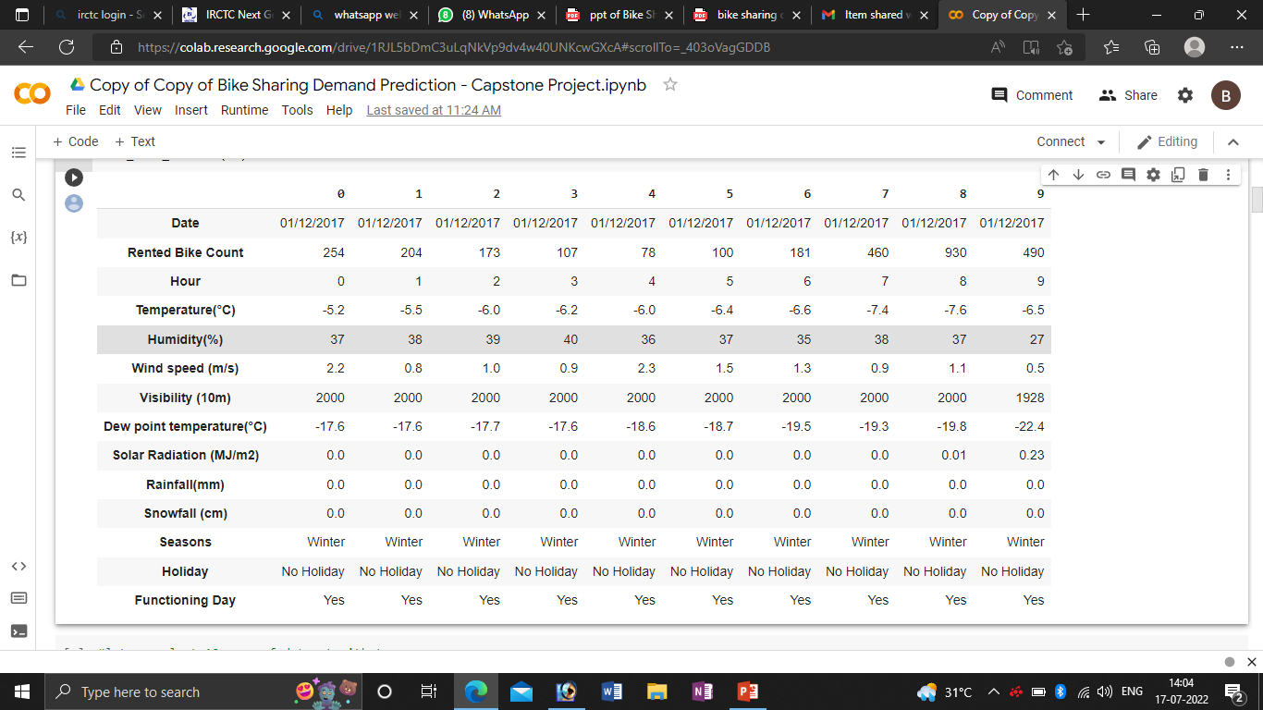
Data summary
➢ This Dataset contains 8760 lines and 14 columns.
➢ Three categorical features ‘Seasons’, ‘Holiday’, & ‘Functioning Day’.
➢ One Datetime features ‘Date’.
➢ We have some numerical type variables such as temperature, humidity, wind, visibility, dew point temp, solar radiation, rainfall, snowfall which tells the environment conditions at that particular hour of the day.

Slide 5
Feature summary
➢ Date : Year-Month-Day
➢ Rented Bike Count - Count of bikes rented at each hour
➢ Hour - Hour of the day
➢ Temperature - Temperature in Celsius
➢ Humidity - %
➢ Wind Speed - m/s
➢ Visibility - 10m
➢ Dew point temperature -Celsius
➢ Solar radiation -MJ/m2
➢ Rainfall -mm
➢ Snowfall -cm
➢ Seasons -Winter, Spring, Summer, Autumn
➢ Holiday -Holiday/No Holiday
➢ Functioning Day

Slide 6
Insights from our dataset
➢ There are No Missing Values present .
➢ There are No Duplicate values present.
➢ There are No null values.
➢ And finally we have 'rented bike count' variable which we need to predict for new observations .
➢ The dataset shows hourly rental data for one year (1 December 2017 to 31 November(2018)(365 days).we consider this as a single year data
➢ So we convert the "date" column into 3 different column i.e "year","month","day".
➢ We change the name of some features for our convenience , they are as below 'Rented_Bike_Count', 'Hour', 'Temperature', 'Humidity', 'Wind_speed', 'Visibility', ‘Dew_point_temperature', 'Solar_Radiation', 'Rainfall', 'Snowfall', 'Seasons', 'Holiday', 'Functioning_Day', 'month','weekdays_weekend'

Slide 7
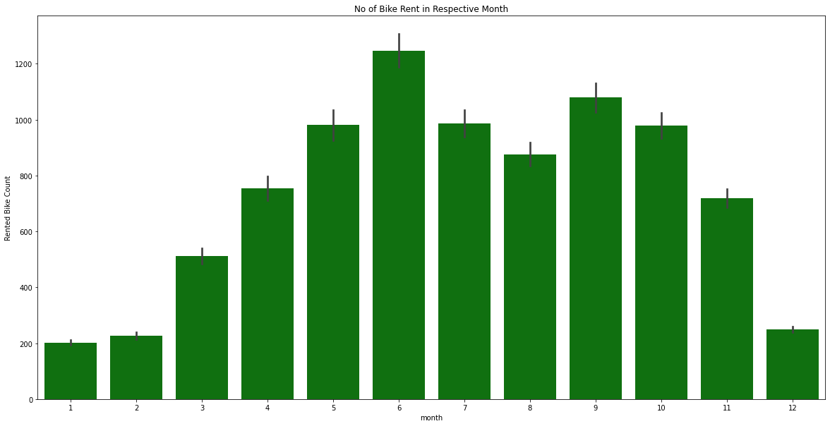
Analysis of Month vs Rented bike

Slide 8
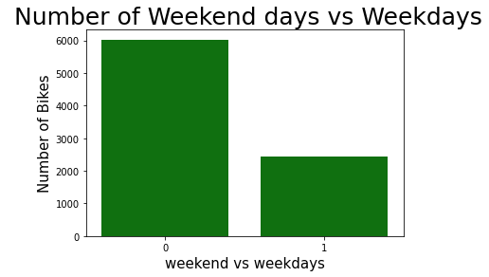
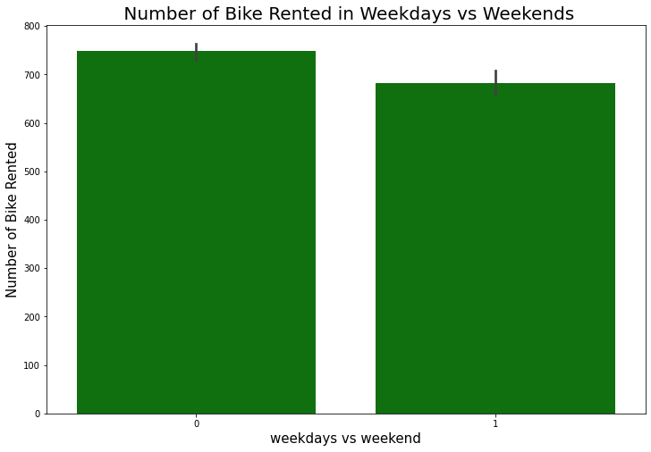
Analysis of rented bike
(Weekend vs weekdays)

Slide 9
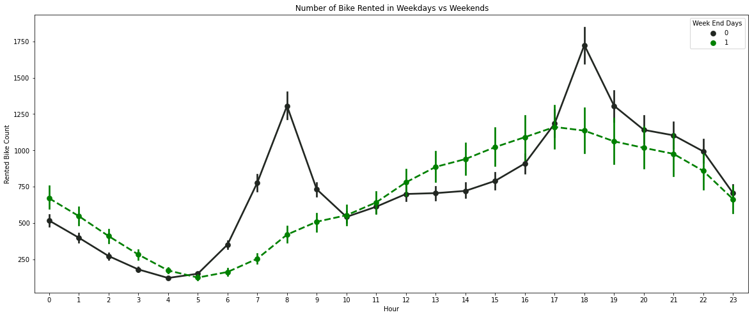
Analysis of rented bike
(HOUR)

Slide 10
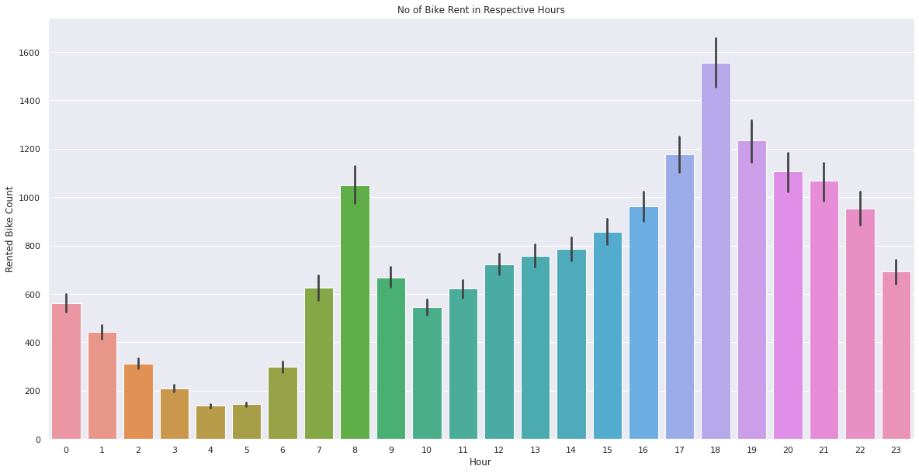
Analysis of rented bike
(HOUR)

Slide 11
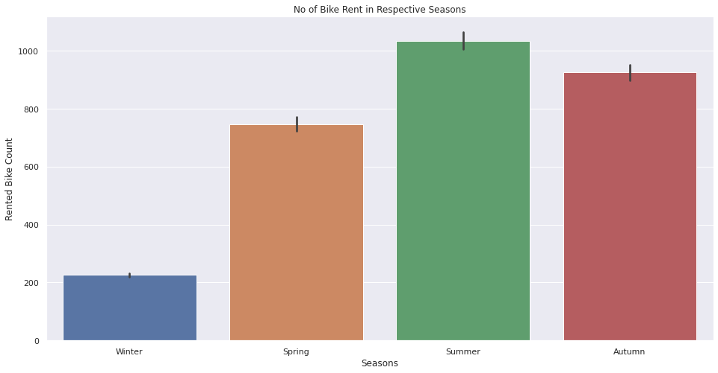
Analysis of rented bike
(SEASON)

Slide 12
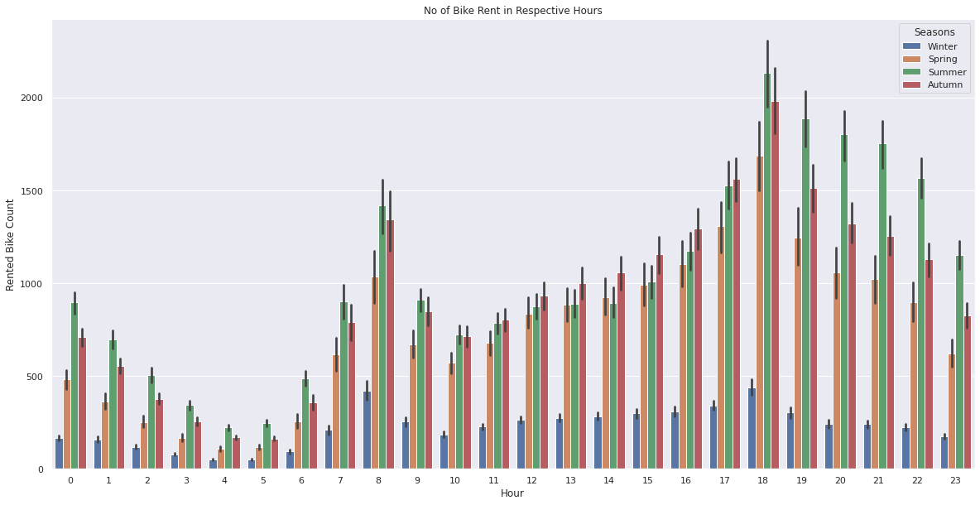
Analysis of rented bike
(Hour and season)

Slide 13
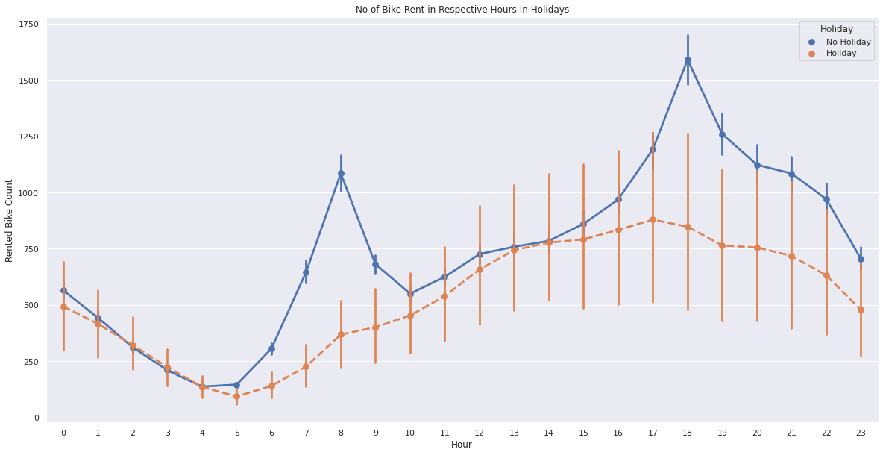
Analysis of rented bike
(Hour and holiday)

Slide 14
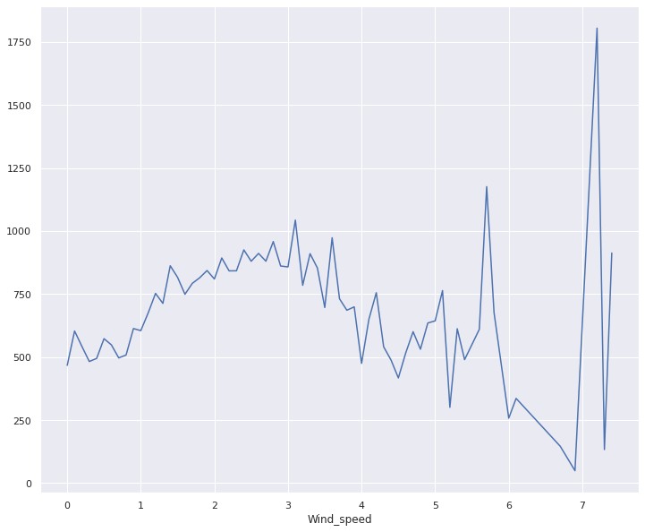
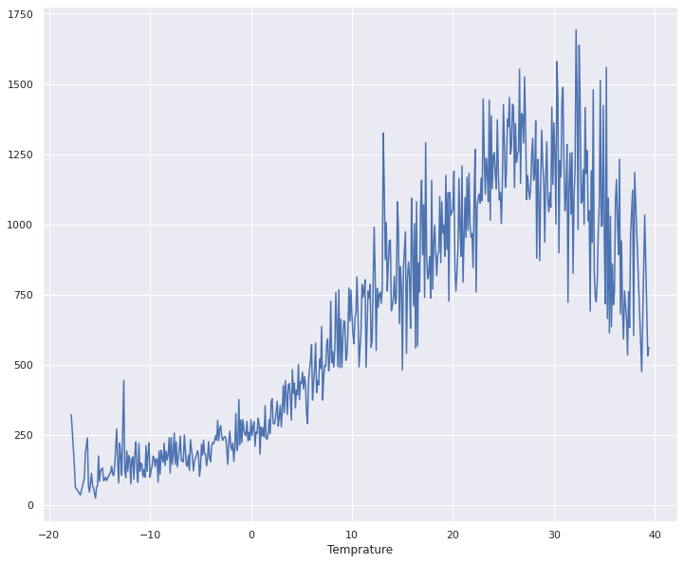
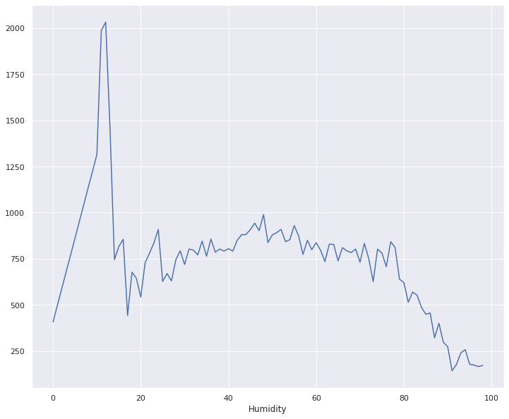
Numerical vs Rented bike count

Slide 15
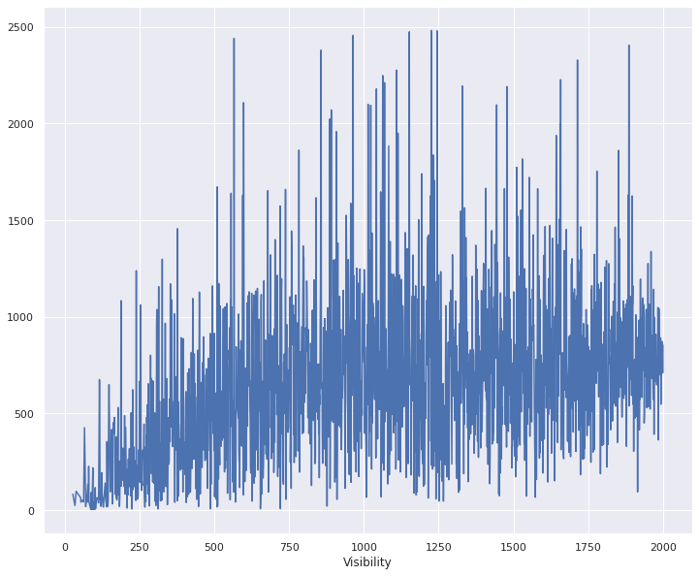
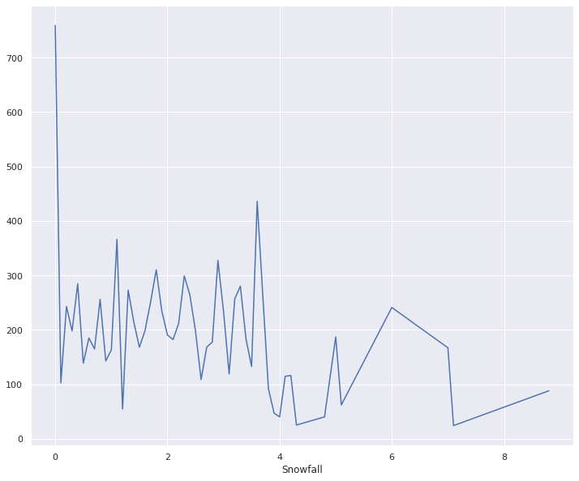
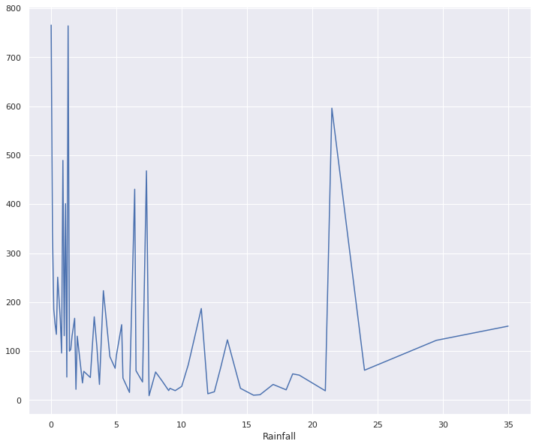
Numerical vs Rented bike count

Slide 16
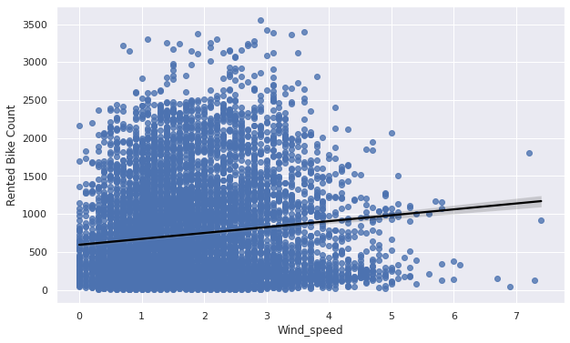
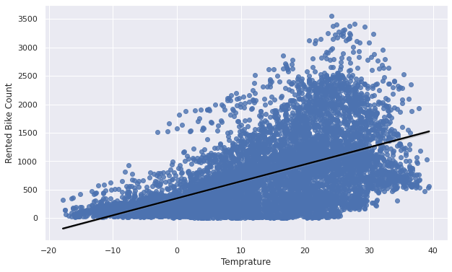
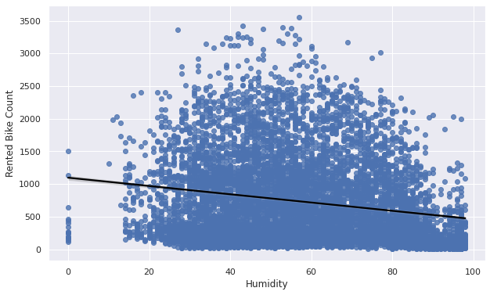
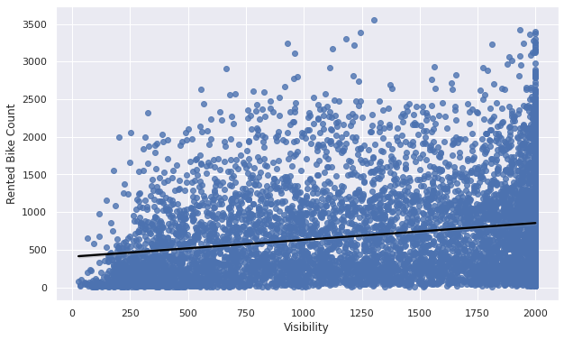
Regression Plot for numerical variable

Slide 17
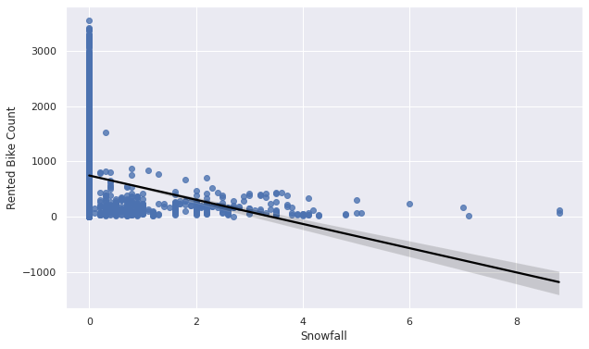
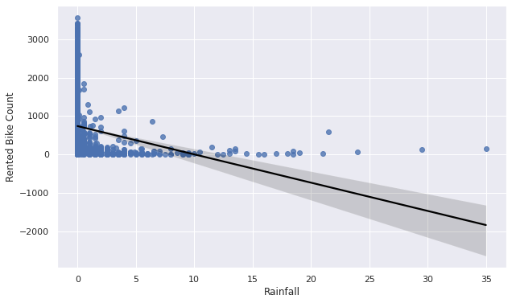
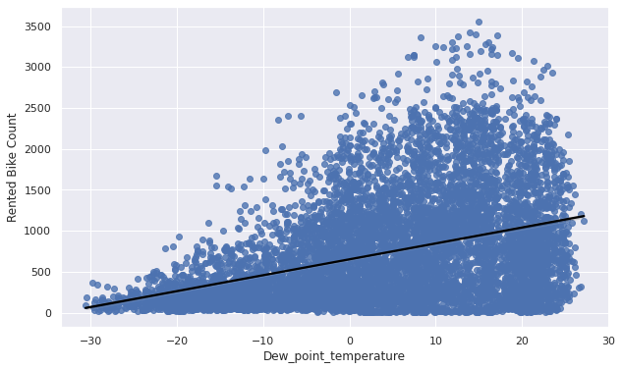
Regression Plot for numerical variable

Slide 18
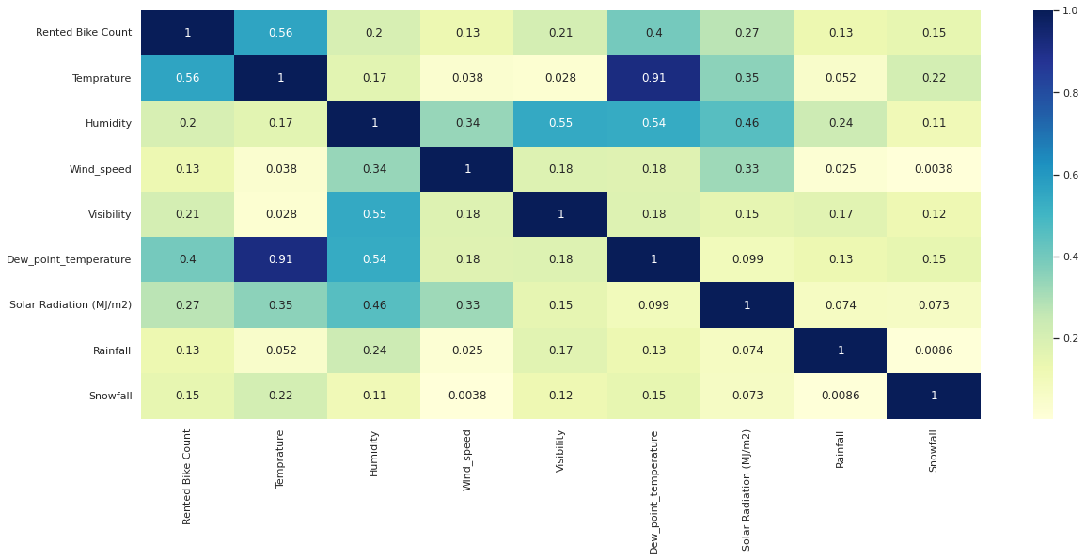
Correlation Heatmap

Slide 19
Model building
➢ LINEAR REGRESSION
➢ LASSO REGRESSION
➢ RIDGE REGRESSION
➢ DECISION TREES REGRESSOR
➢ RANDOM FOREST REGRESSOR
➢ GRADIENT BOOSTED REGRESSOR
➢ GRADIENT BOOSTING REGRESSOR WITH GRIDSEARCHCV

Slide 20
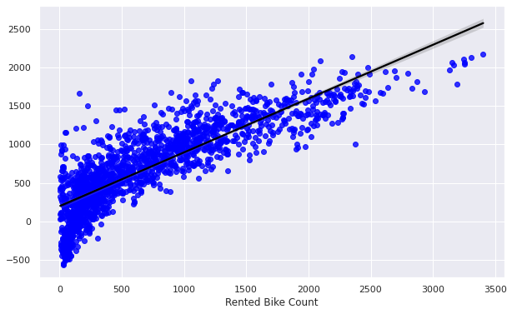
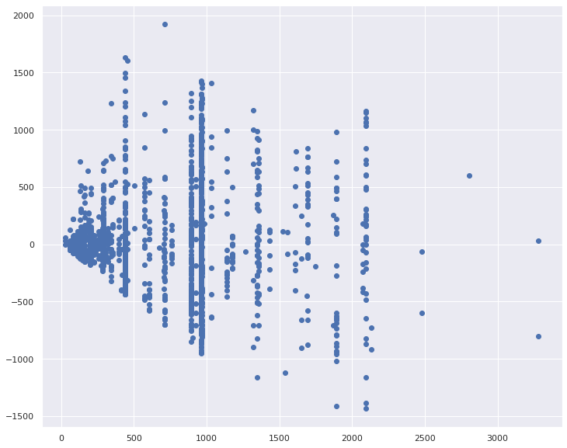
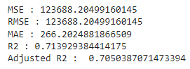
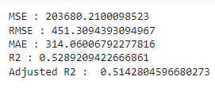
Linear Regression
Decision Tree

Slide 21
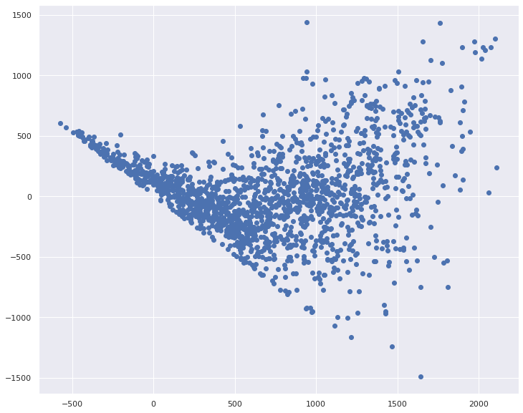
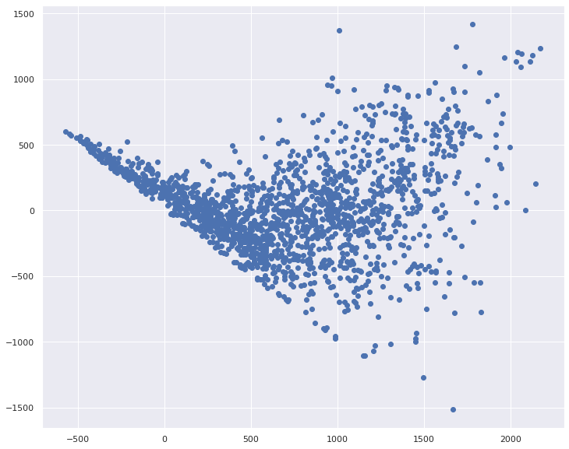
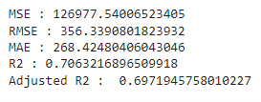
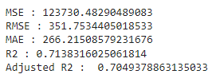
Lasso Regression
Ridge Regression

Slide 22
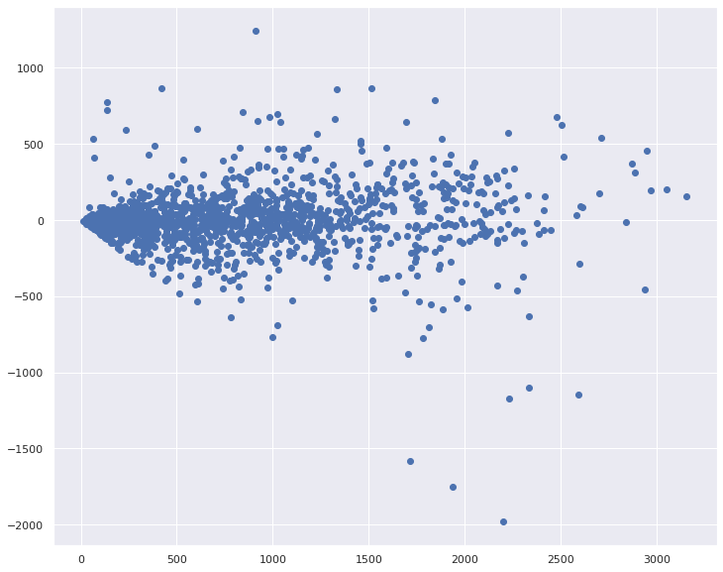
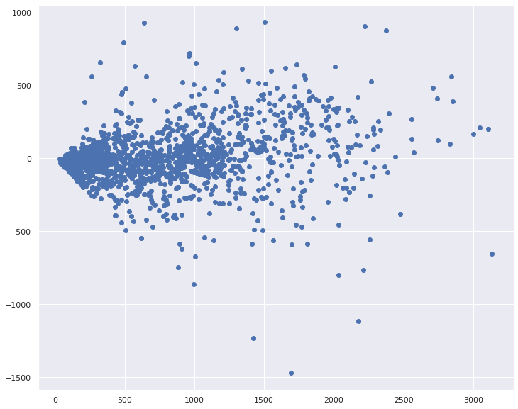
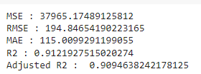
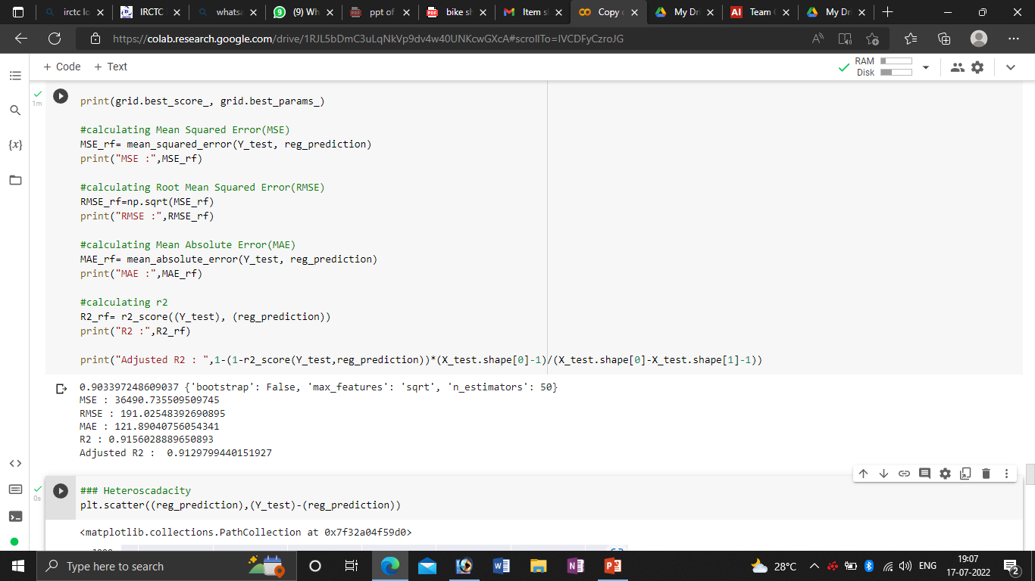
Random Forest
Random Forest with tuning

Slide 23
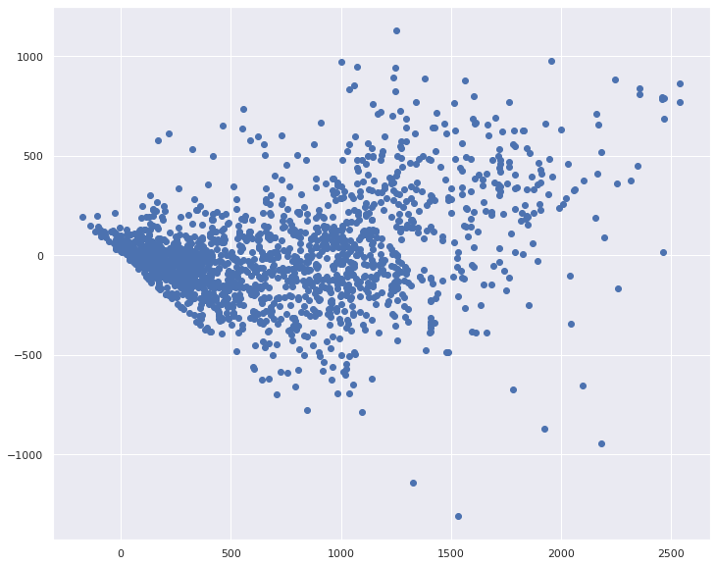
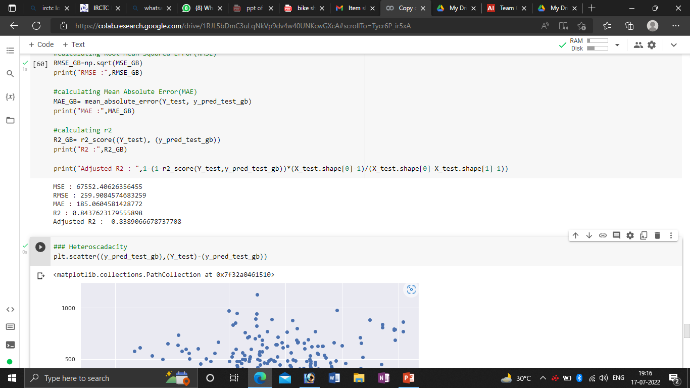
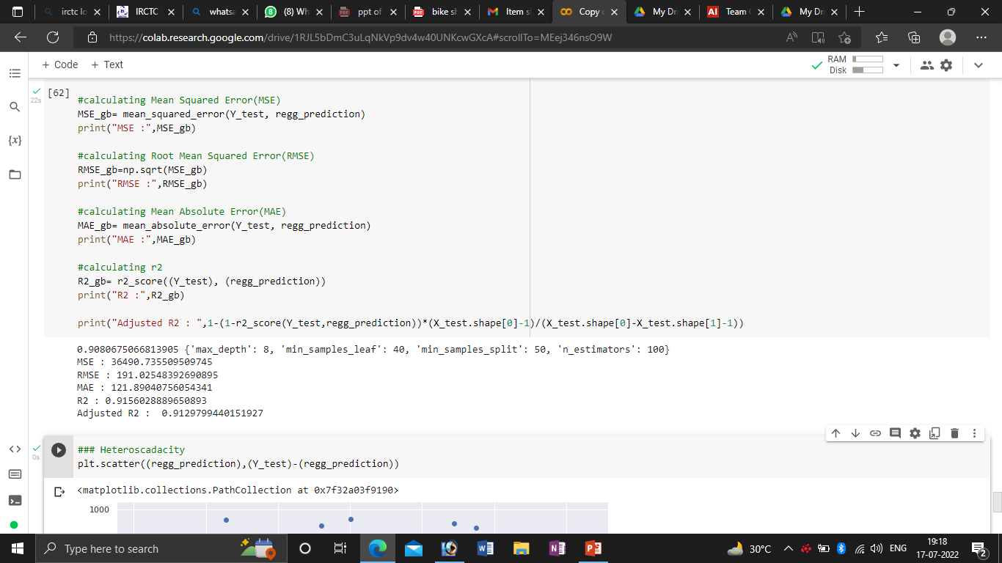
Gradient Boosting
Gradient Boosting with tuning

Slide 24
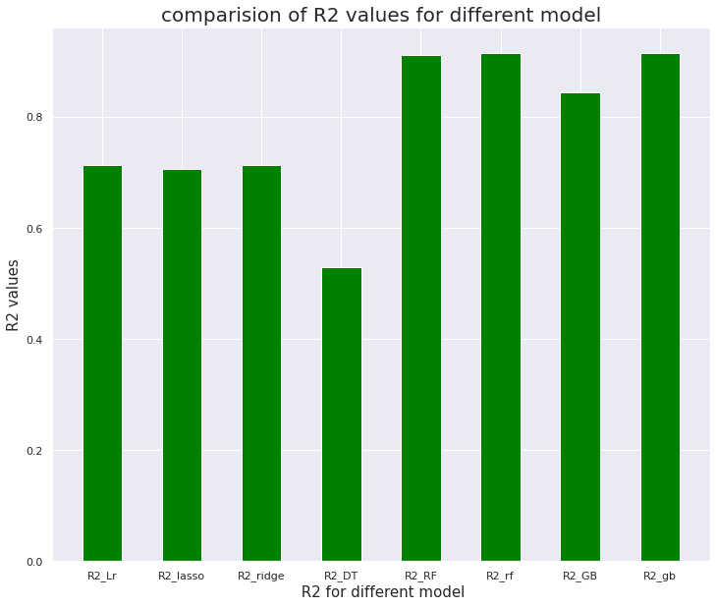
Comparison of R2 values for different model

Slide 25
Conclusion
➢ ‘Hour’ of the day holds the most important feature.
➢ Bike rental count is mostly correlated with the time of the day as it is peak at 10 am morning and 8 pm at evening.
➢ We observed that bike rental count is high during working days than non working day.
➢ We see that people generally prefer to bike at moderate to high temperatures, and when little windy
➢ It is observed that highest number bike rentals counts in Autumn & Summer seasons & the lowest in winter season. We observed that the highest number of bike rentals on a clear day and the lowest on a snowy or rainy day. We observed that with increasing humidity, the number of bike rental counts decreases.

Slide 26
Thank You

